Slide 1
Software Development Process

Slide 2
What is software ?
Software is a set of instructions, data or programs used to operate computers and execute specific tasks. It is the opposite of hardware, which describes the physical aspects of a computer. Software is a generic term used to refer to applications, scripts and programs that run on a device.
What is Software Engineering?
Software Engineering is the process of designing, developing, testing, and maintaining software. It is a systematic and disciplined approach to software development that aims to create high-quality, reliable, and maintainable software.
The main goal of Software Engineering is to develop software applications for improving quality, budget, and time efficiency.
Software engineering includes a variety of techniques, tools, and methodologies, including requirements analysis, design, testing, and maintenance.

Slide 3
Characteristics of Software in Software Engineering :
1] Software is developed or engineered: it is not manufactured in the classical sense:
Software, however, is an intangible product(Software is intangible because it does not have a physical form like a chair, phone, or book.).
It is created by software engineers through designing, coding, testing, and debugging.
This process is more about intellectual and creative work rather than physical production.
Once developed, software can be copied, installed, or distributed without additional manufacturing effort or cost.
Therefore, the creation of software is referred to as development or engineering, not manufacturing.

Slide 4
2] The software doesn’t “wear out” :
In the case of software: Software is made of code and digital instructions, not physical components.
It does not wear out with use—running a program 100 or 1,000 times doesn’t damage it .
In the physical world, things like machines, or batteries wear out because they have moving parts or materials that degrade over time due to repeated use.
software won’t stop working just because it's been used many times.
When a hardware component wears out, it is replaced by a spare part, There are no software spare parts.
Every software failure indicates an error in design or in the process through which the design was translated into machine-executable code.
Hardware wears out physically; software does not.
Software deteriorates logically and functionally, requiring careful maintenance to manage complexity and keep it reliable.

Slide 5
3] Most Software is Custom Built , rather than being assembled from existing components .
A Software Components should be designed and implemented such a way that it can be reused in many different programs.
Reusable parts include :
data (information) and the procedures (steps or methods) to work on that data.
This allows programmers to combine these parts to build new software efficiently.
In hardware, reuse is natural:
When engineers build physical devices (hardware), reusing components like chips, circuits, or mechanical parts is common and expected.
It’s easier because hardware components are physical and standardized.
In software, reuse needs planning:
Software parts have to be carefully designed and planned so they can be reused effectively across multiple projects.

Slide 6
TYPES OF SOFTWARE :
1. System Software
Definition:
System software manages and controls computer hardware so that application software can function. It acts as a bridge between hardware and user-level applications.
Examples:
Operating Systems: Windows, Linux, macOS
Utility Programs: Disk cleanup tools, antivirus software
Device Drivers: Printer driver, graphics card driver
2. Application Software
Definition:
Application software is designed for end-users to perform specific tasks such as word processing, web browsing, or playing music.
Examples:
Microsoft Word (word processing) , Google Chrome (web browsing) , Adobe Photoshop (image editing)
3. Embedded Software
Definition:
Embedded software is built into hardware devices and is used to control specific functions of that device. It’s usually found in non-PC devices.
Examples:
Software in washing machines
Firmware in smartphones
Code in microwave ovens or smart TVs

Slide 7
4. Real-Time Software
Definition:
Real-time software responds instantly to inputs or events and is used in systems where timing is critical.
Examples:
Air traffic control systems
Medical monitoring systems (e.g., heart monitors)
Industrial robots and automation systems
5. Product-Line Software
Definition:
Product-line software refers to a set of related software products that share common features but can be customized for different markets or customers.
Examples:
Microsoft Office Suite (Word, Excel, PowerPoint, each with shared functionality)
Video game engines with different games built on the same code base
Car infotainment systems tailored for various models
6. Scientific Software
Definition:
Scientific software is used for scientific research, simulations, calculations, and analysis.
Examples:
MATLAB (mathematics and engineering simulations)
SPSS (statistical analysis)
CERN’s particle physics software

Slide 8
7. Web-Based Software
Definition:
Web-based software is accessed via a web browser and runs on remote servers, not on the user’s local machine.
Examples:
Google Docs
Facebook
Online banking systems
8. AI Software
Definition:
AI (Artificial Intelligence) software mimics human intelligence and is used for learning, reasoning, and problem-solving.
Examples:
ChatGPT (language processing)
Alexa (virtual assistants)
Self-driving car software (e.g., Tesla Autopilot)
9. Personal Computer Software
Definition:
This refers to software intended for use on personal computers, helping users perform everyday tasks.
Examples:
Microsoft Office (document editing)
VLC Media Player (media playback)
Steam (PC gaming platform)

Slide 9
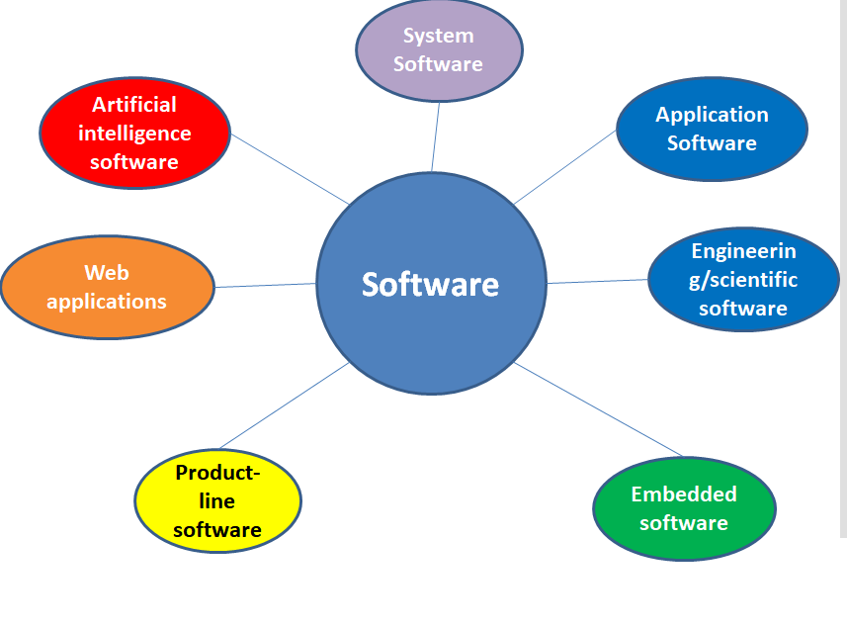

Slide 10
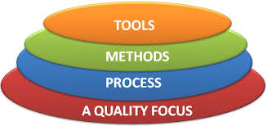
The Process: Software Engineering: A Layered approach -Process, Methods and Tools :
A process is defined as a series of steps involving activities and resources which produces the desired output.
Software Engineering is a layered technology , Means to develop software one will have to go from one layer to another.
A layered Technology approach ensures well designed software product .
The layer are related and each layer demands the fulfillment of the previous layer.

Slide 11
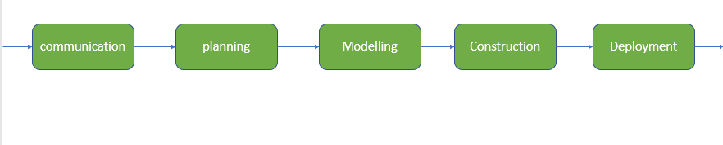
Tools:
The first layer involves choosing the semi-automated and automated tools that will become the framework for the project. Some examples may include:
Choosing Microsoft Publisher for web design
Using Selenium for testing across platforms
Using an integrated development environment (IDE) for building apps
Tools are integrated which means information created by one tool can be used by another
Method:
During the process of software development the answers to all "how-to-do" questions are given by method.
It has the information of all the tasks which includes communication, requirement analysis, design modeling, program construction, testing, and support.
Process :
It is the foundation or base layer of software engineering.
It is key that binds all the layers together which enables the development of software before the deadline or on time.
Process defines a framework that must be established for the effective delivery of software engineering technology.
The software process covers all the activities, actions, and tasks required to be carried out for software development.

Slide 12
A Quality Focus :
At this point, the software is developed and refined to a point, but it is critical to apply quality control to the finished product.
Besides testing the end product to ensure that it meets the client’s specifications,
It also needs real-world testing to determine how efficient, usable, and reusable it will be, It needs to explore how many resource maintenance will require.
If it is replacing an older software or platform, quality control will ensure the new software will meet the needs.

Slide 13
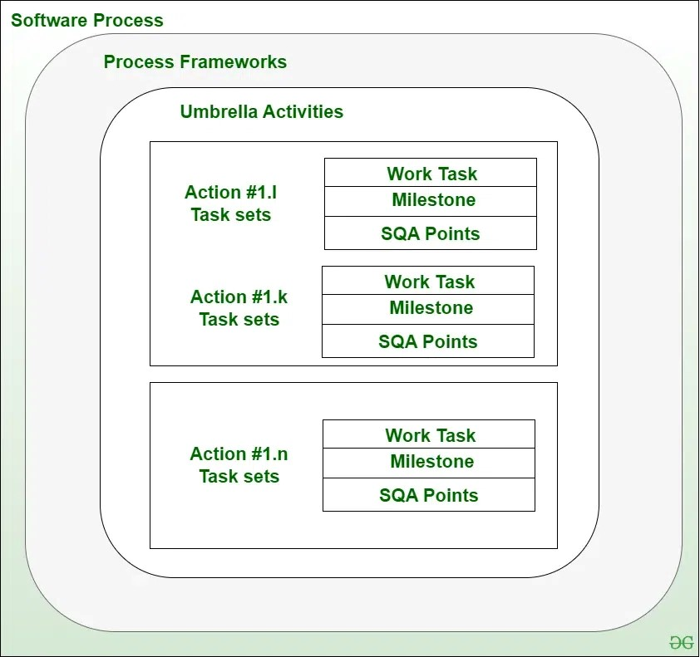
Software Process Framework :
A Software Process Framework is a structured approach that defines the steps, tasks, and activities involved in software development, Software Process Framework details the steps and chronological order of a process.
A Software Process Framework helps in project planning, risk management, and quality assurance by detailing the chronological order of actions.
It includes task sets, umbrella activities, and process framework activities, all essential for a successful software development lifecycle.
A process framework contains a set of umbrella activities that are applicable across the entire software process.

Slide 14
Software Process Framework Activities :
Communication, planning, modeling, construction, and deployment are 5 process framework activities can be used during the development of small program , the creation of large web application and for engineering large complex computer based system.
1. Communication :
Definition: Communication involves gathering requirements from customers and stakeholders to determine the system's objectives and the software's requirements.
Effective communication is essential to understand what the users need from the software.
Activities: To communicate with client
Requirement Gathering: Engaging with consumers and stakeholders through meetings, interviews, and surveys to understand their needs and expectations.
Objective Setting: Clearly defining what the system should achieve based on the gathered requirements.
2. Planning :
Definition: Planning involves establishing an engineering work plan, describing technical risks, listing resource requirements, and defining a work schedule.
Activities:
Work Plan: Creating a detailed plan that outlines the tasks and activities needed to develop the software.
Risk Assessment: Identifying potential technical risks and planning how to mitigate them.
Resource Allocation: Determining the resources (time, personnel, tools) required for the project.
Schedule Definition: Setting a timeline for completing different phases of the project.

Slide 15
3. Modeling :
Definition: Modeling involves creating architectural models and designs to better understand the problem and work towards the best solution.
Modeling activity contains the creation of models that allow the developer & the customer to better understand software requirements .
Activities: Creation of model
Analysis of Requirements: Breaking down the gathered requirements to understand what the system needs to do.
Design: Creating architectural and detailed designs that outline how the software will be structured and how it will function.
Explanation: Modeling translates requirements into a visual and structured representation of the system. It helps in identifying the best design approach and serves as a blueprint for development.
4. Construction :
Definition: Construction involves creating code, testing the system, fixing bugs.
Activities: Code Generation: Writing the actual code based on the design models.
Testing: Running tests to ensure the software works as intended, identifying and fixing bugs.
This phase is where the actual software is built. Testing is necessary to ensure that the code is error-free and that the software meets all specified requirements.
5. Deployment :
Definition: Deployment involves presenting the product or software to customers for evaluation and feedback, then making necessary modifications based on their input.
Activities: To deliver a project
Product Release: Delivering the software to users, either as a full release or in stages.
Feedback Collection: Gathering feedback from users about their experience with the software.
Product Improvement: Making changes and improvements based on user feedback to enhance the product.

Slide 16
Umbrella Activities :
Cover or span across the entire software development process, just like an umbrella covers everything under it.
Umbrella Activities that take place during a software development process for improved project management and tracking.
Software project tracking and control: This is an activity in which the team can assess progress and take corrective action to maintain the schedule. Take action to keep the project on time by comparing the project's progress against the plan.
Risk management: The risks that may affect project outcomes or quality can be analyzed. Analyze potential risks that may have an impact on the software product's quality and outcome.
Software quality assurance: These are activities required to maintain software quality. Perform actions to ensure the product's quality.
Formal technical reviews:
A Formal Technical Review (FTR) is a structured and planned meeting where a team of software engineers examines software products or processes to ensure:
✅ Correctness
✅ Quality
✅ Consistency with standards
✅ Error detection early in development
It is required to assess engineering work products to uncover and remove errors before they propagate to the next activity. At each level of the process, errors are evaluated and fixed.

Slide 17
Software configuration management: Managing of configuration process when any change in the software occurs. it is a process in software engineering that focuses on controlling and tracking changes in the software.
Work product preparation and production: Work products are physical results of software engineering tasks. Examples include:
✅ Requirements documents
✅ Design models (UML diagrams, flowcharts)
✅ Source code
✅ Test plans and cases
✅ Project logs and reports
✅ forms, or configuration files
Reusability management: It defines criteria for work product reuse. Reusable work items should be backed up, and reusable software components should be achieved.
Measurement: The process of collecting and analyzing data related to software processes, products, and projects to support better planning, tracking, and improvement.
Purpose:
To monitor progress
To evaluate quality
To predict cost, effort, and time
To identify risks early
To support decision-making

Slide 18
Software Development Framework :
A Software development framework is a pre-built structure or collection of tools , libraries & guidelines that developers use to create software application efficiently.
It acts as an abstraction that hides internal complexities and provides application-specific functionality.
Offers a standard way to build and deploy applications.
🔹 Why It’s Important:
Guides the development, deployment, and maintenance of software systems.
Ensures quality, consistency, and efficiency across the software development lifecycle.
Stages in Software Development Process
Development Phase | Description
Requirements Definition | Understanding what the software should do
Architecture Definition | Planning the software's overall structure
Design | Creating detailed design documents
Implementation | Writing and testing the code
Integration | Combining different parts of the system
Product Testing | Verifying if the product meets requirements
Acceptance Testing | Final validation with the client/user

Slide 19
Underlying Process Activities :
Process Definition – Identifying and documenting what the software process should achieve.
Process Design – Structuring how the defined process will be executed.
Process Implementation – Carrying out the process using tools and resources.
Qualification – Verifying that the process and product meet all requirements.
Advantages of Software Development Framework :
Faster Development – Provides pre-built modules to speed up coding.
Code Maintainability – Code is easier to manage and update.
Better Security – Many frameworks include built-in security mechanisms.
Cross-Platform Support – Supports development for different OS/devices.
Scalability – Handles large-scale software applications efficiently.

Slide 20
